Slide 1

Local Binary Patterns

Slide 2
A table of Contents
The basic LBP operation
1
Extensions
2
CODE
3
Application and Summary
4

Slide 3

Part 1
The basic LBP operation

Slide 4
The basic LBP operation [1]
Samples for LBP operations [1]

Slide 5
The basic LBP operation [1]
Samples for LBP operations [1]

Slide 6
The basic LBP operation [1]
Samples for LBP operations [1]

Slide 7
The basic LBP operation [1]
Samples for LBP operations [1]

Slide 8
The basic LBP operation [1]
Samples for LBP operations [1]

Slide 9
The basic LBP operation [1]
Samples for LBP operations [1]

Slide 10
The basic LBP operation [1]
Samples for LBP operations [1]

Slide 11
The basic LBP operation [1]
Samples for LBP operations [1]

Slide 12
The basic LBP operation [1]
BIN: 11001011 DEC: 203
Samples for LBP operations [1]

Slide 13
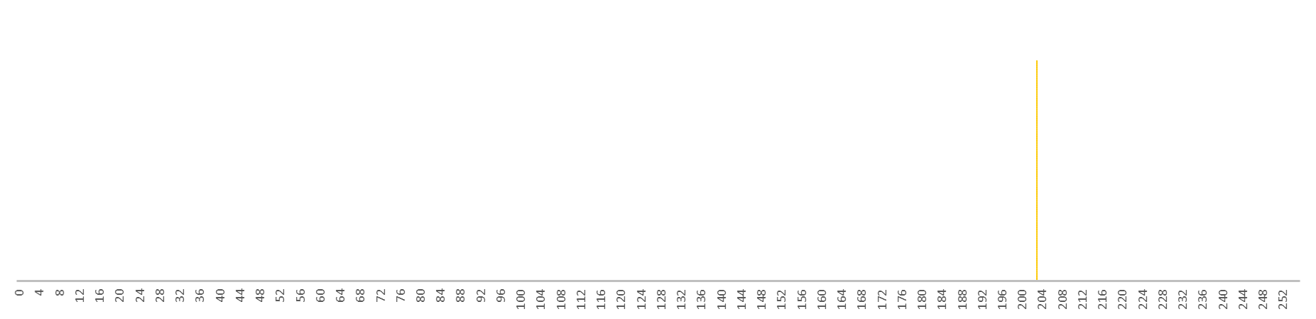
The basic LBP operation [1]

Slide 14
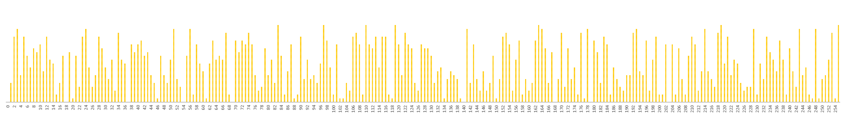
The basic LBP operation [1]

Slide 15
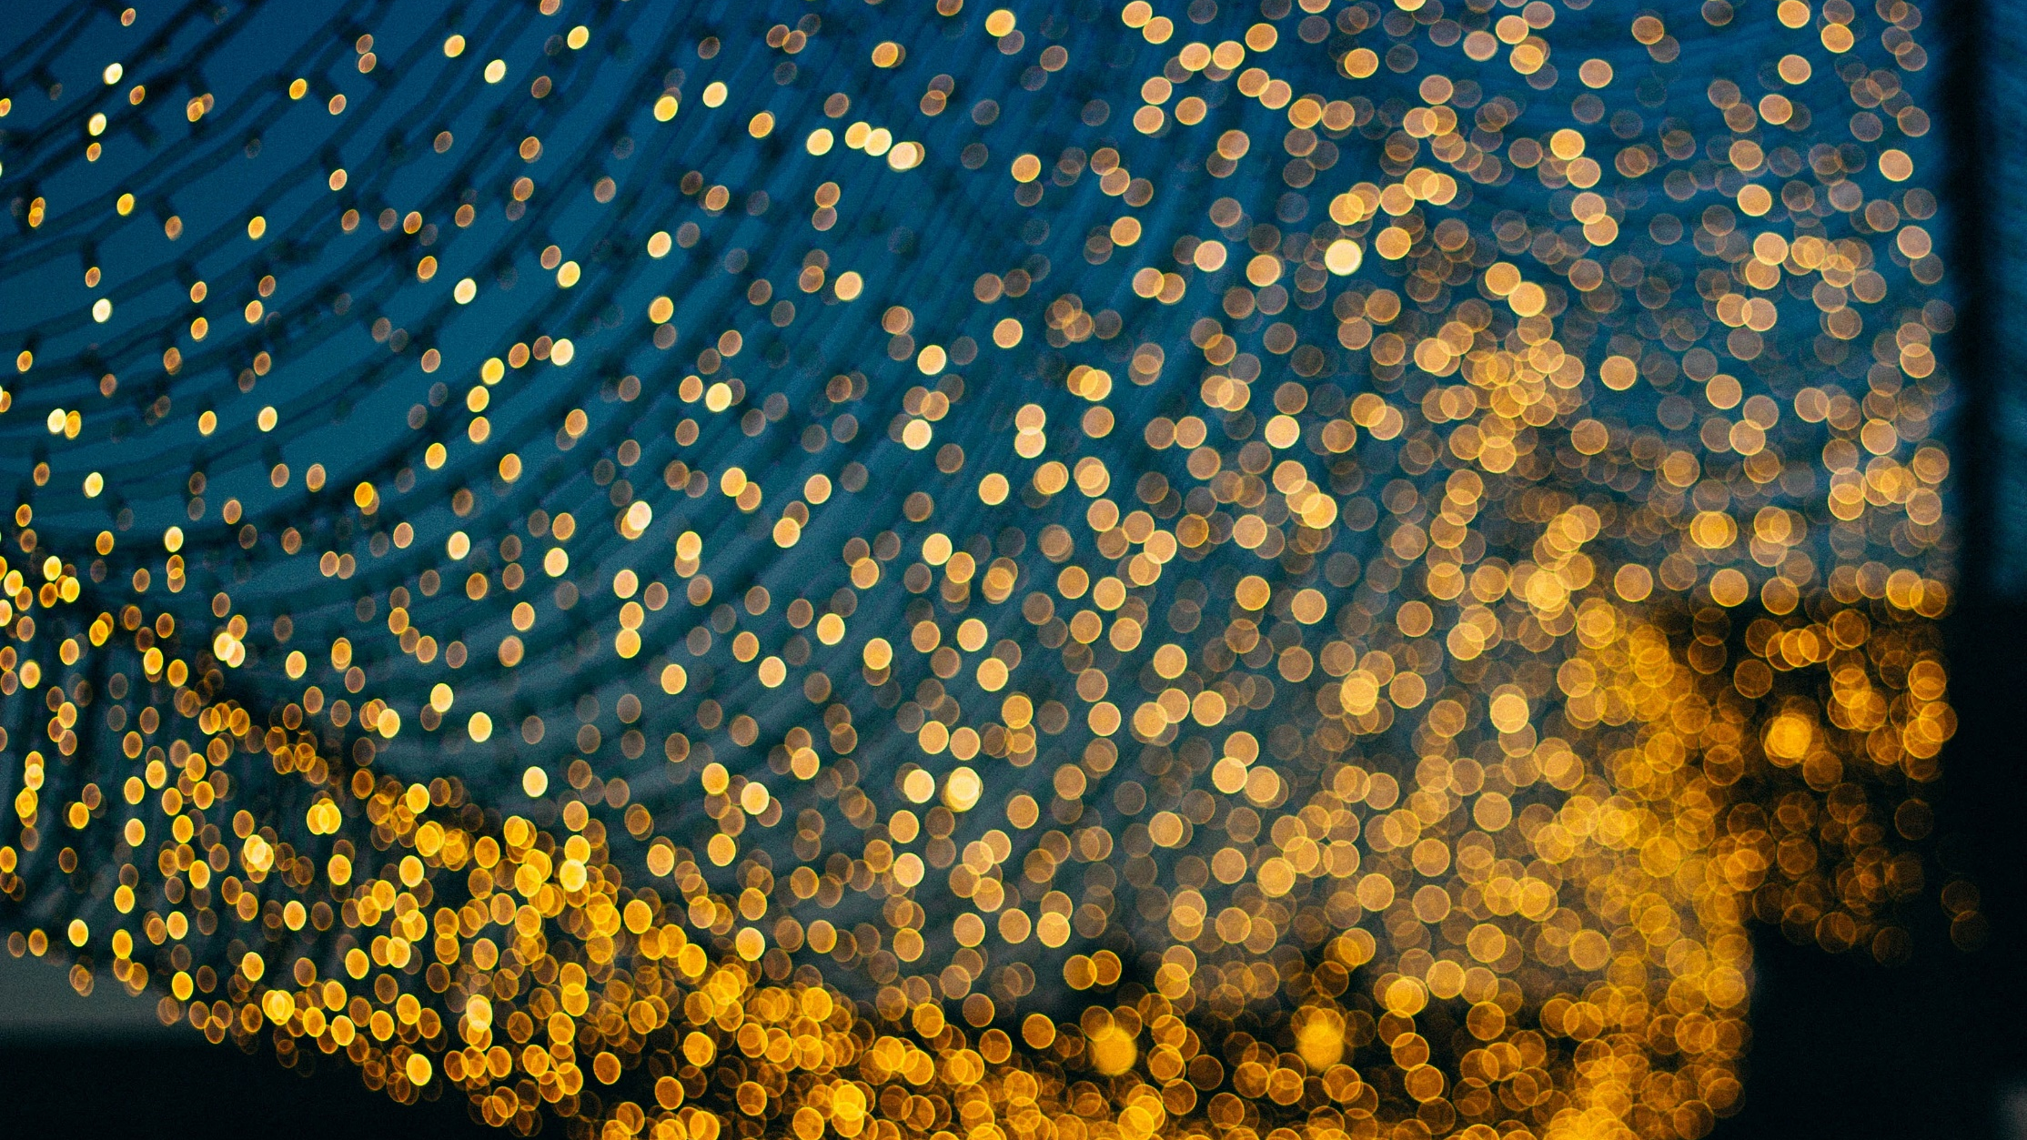
Part 2
Extensions

Slide 16
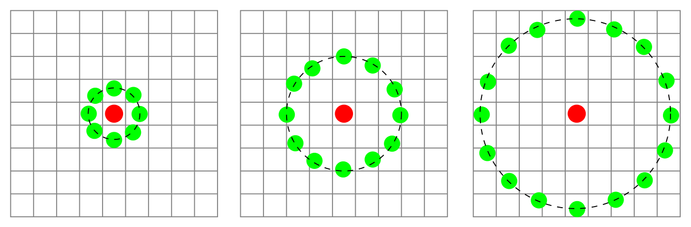
Circular LBP[3]
Three neighborhood examples used to define a texture and calculate a local binary pattern (LBP) [2]

Slide 17
Circular LBP[3]
P = 8, 256 (2⁸)
P = 12, 4,096 (2¹²)
P = 16, 65,536 (2¹⁶)
P = 24, 16,777,216 (2²⁴)
(-Rsin(2πp/P), Rcos(2πp/P))
Circularly symmetric neighbor sets for different (P,R) [3]
Notes:
(-Rsin(2πp/P), Rcos(2πp/P))의 결과는 실수, Bilinear 보간법을 이용해 특정 픽셀의 위치를 찾아 연산.

Slide 18
Uniform LBP[3]
00110011

Slide 19
Uniform LBP[3]
00110011

Slide 20
Uniform LBP[3]
00110011

Slide 21
Uniform LBP[3]
Uniform | Non-Uniform
 | 00110011

Slide 22
Uniform LBP[3]
Uniform | Non-Uniform
11000011 | 00110011
11000011

Slide 23
Uniform LBP[3]
Uniform | Non-Uniform
58개 | 198개

Slide 24
Uniform LBP[3]
Uniform | Non-Uniform
58개 | 198개
Non-Uniform features(198개), 1개로 통합

Slide 25
Uniform LBP[3]
Uniform | Non-Uniform
58개 | 198개
256개의 특징을 59개로 표현!

Slide 26
Uniform LBP[3]
59/256
Uniform | Non-Uniform
58개 | 198개
256개의 특징을 59개로 표현!

Slide 27
Rotation-invariant LBP

Slide 28
Rotation-invariant LBP

Slide 29
Rotation-invariant LBP
11001011
00101111

Slide 30
Rotation-invariant LBP
SHIFT | 11001011
1 | 10010111
2 | 00101111
3 | 01011110
4 | 10111100
5 | 01111001
6 | 11110010
7 | 11100101

Slide 31
Rotation-invariant LBP
SHIFT | 11001011
1 | 10010111
2 | 00101111
3 | 01011110
4 | 10111100
5 | 01111001
6 | 11110010
7 | 11100101
1/8

Slide 32

Part 3
CODE

Slide 33
CODE [4]
GitHub: ipynb, https://goo.gl/N3bQ8p [4]
GitHub: py, https://goo.gl/nwjtoV [4]
NBViewer, https://goo.gl/pCxFWB [4]

Slide 34
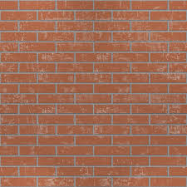
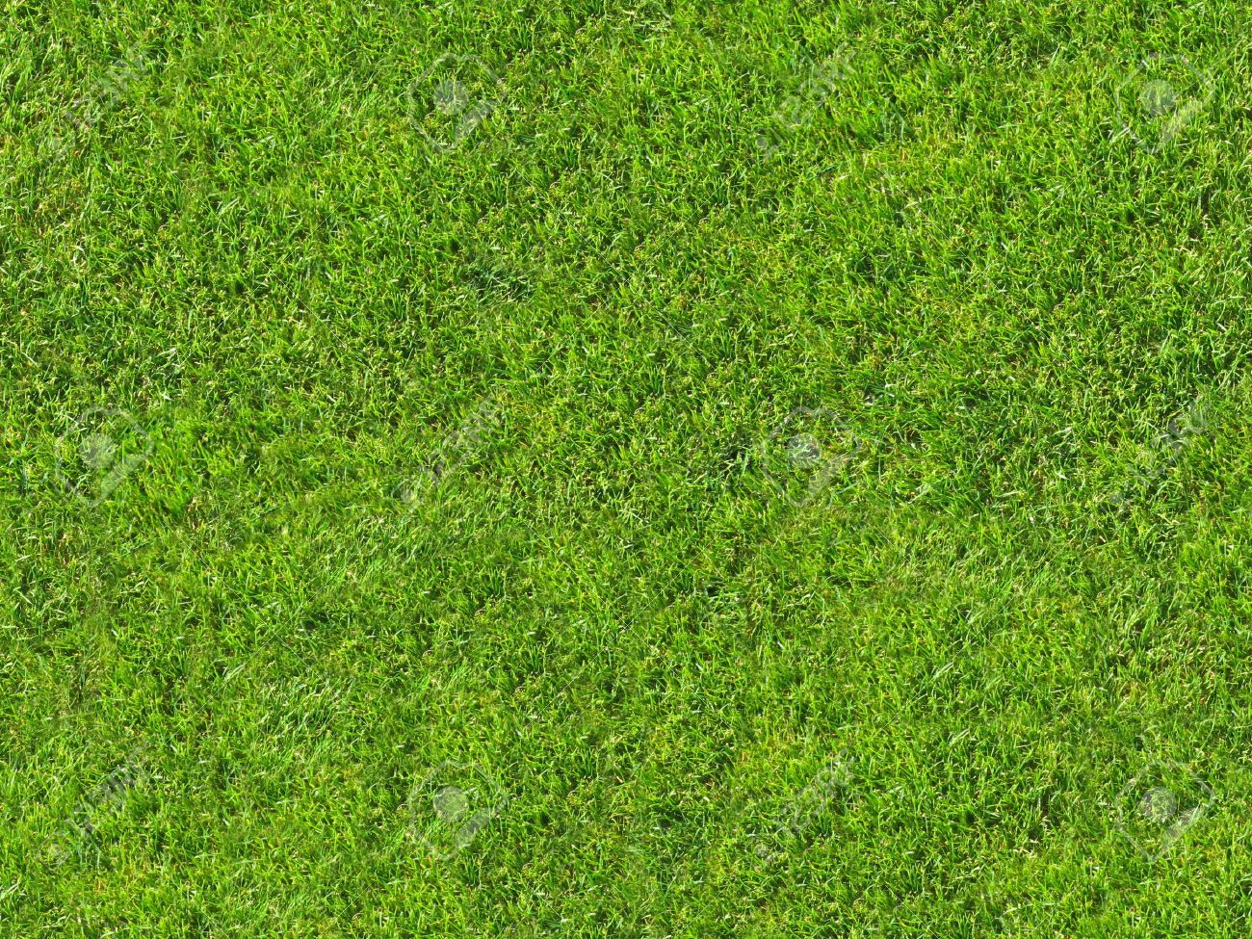
CODE [4]
Texture #1: brick
Texture #2: grass

Slide 35
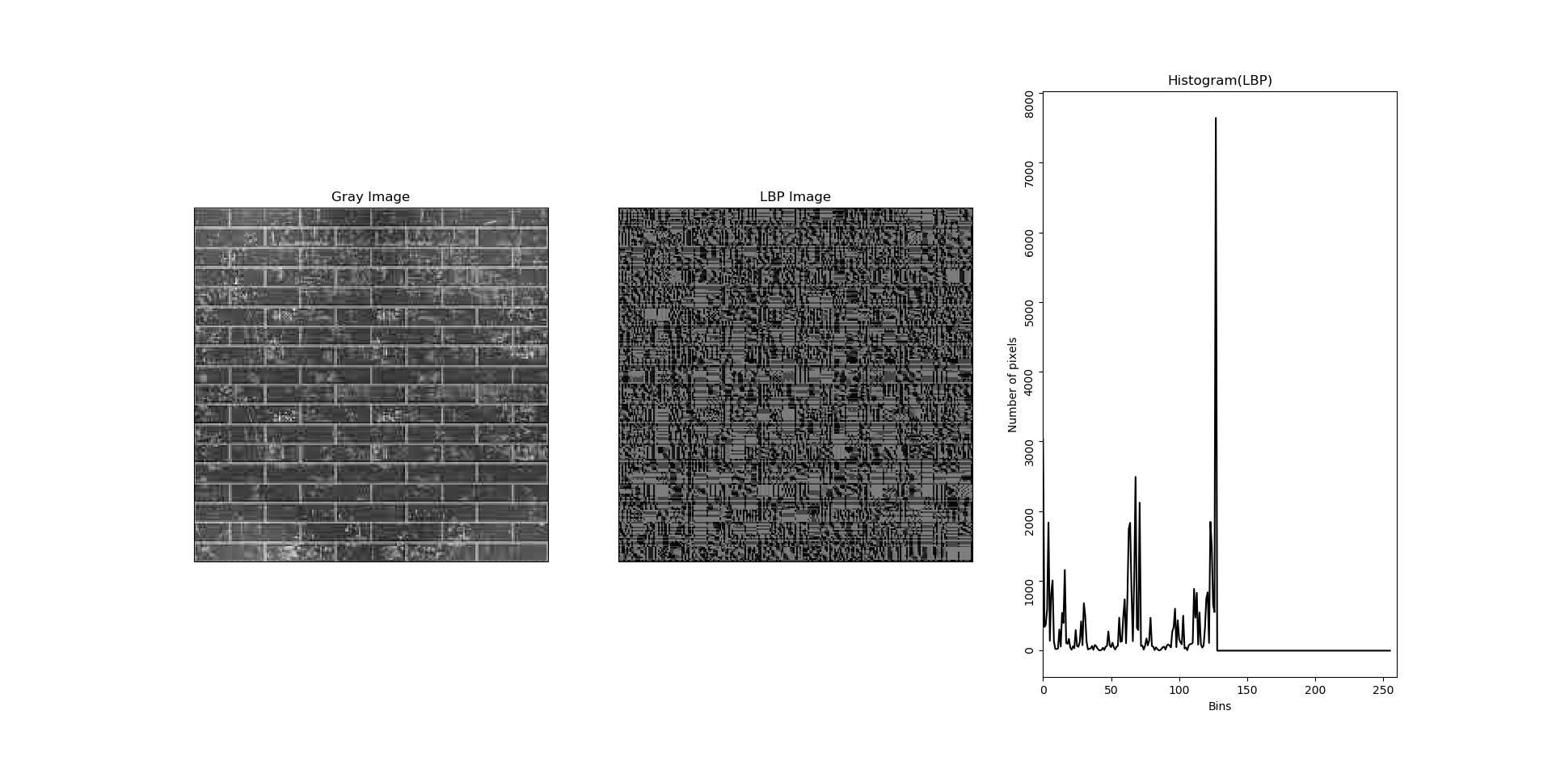
CODE [4]
Texture #1: brick LPB

Slide 36
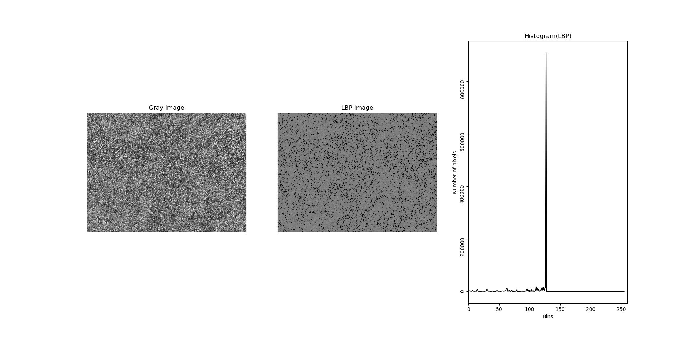
CODE [4]
Texture #2: grass LPB

Slide 37
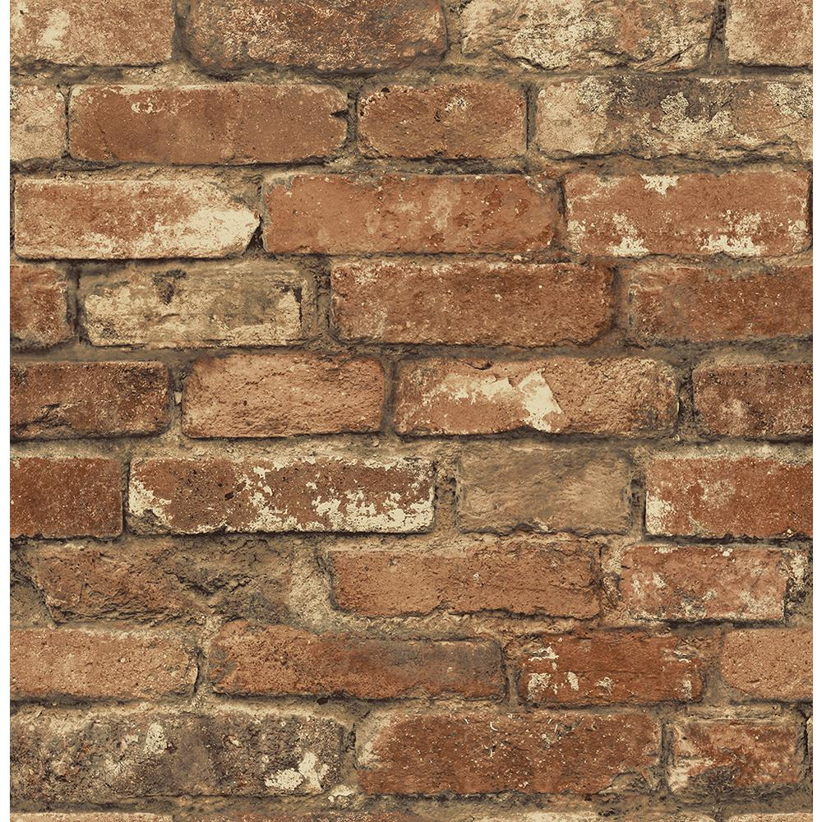
CODE [4]
Texture #3: TARGET

Slide 38
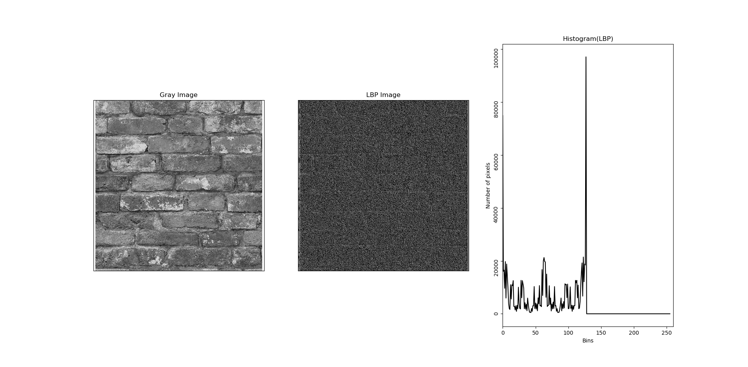
CODE [4]
Texture #3: target LPB

Slide 39
CODE [4]
Brick(left), Grass(center), Target(right)

Slide 40
CODE [4]
76%
19%
Brick(left), Grass(center), Target(right)

Slide 41
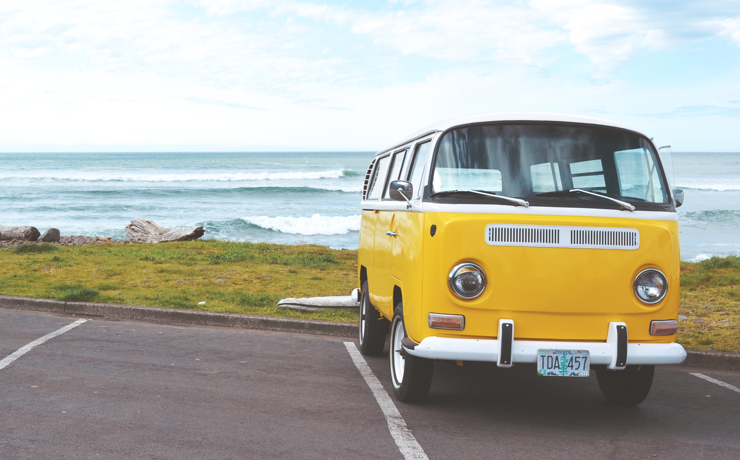
Part 4
Application
and
Summary

Slide 42
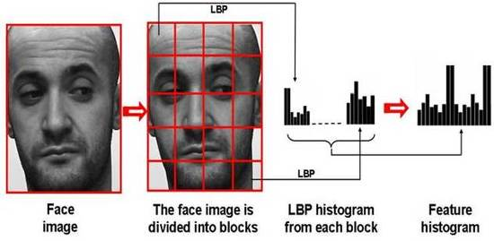
MB-LBP
In this paper, we propose a novel representation, called Multi-scale Block Local Binary Pattern (MB-LBP), and apply it to face recognition. The Local Binary Pattern (LBP) has been proved to be effective for image representation, but it is too local to be robust. In MB-LBP, the computation is done based on average values of block subregions, instead of individual pixels. In this way, MB-LBP code presents several advantages: (1) It is more robust than LBP; (2) it encodes not only microstructures but also macrostructures of image patterns, and hence provides a more complete image representation than the basic LBP operator; and (3) MB-LBP can be computed very efficiently using integral images. Furthermore, in order to reflect the uniform appearance of MB-LBP, we redefine the uniform patterns via statistical analysis. Finally, AdaBoost learning is applied to select most effective uniform MB-LBP features and construct face classifiers. Experiments on Face Recognition Grand Challenge (FRGC) ver2.0 database show that the proposed MB-LBP method significantly outperforms other LBP based face recognition algorithms.

Slide 43
Summary
간단한 연산, 효율적인 텍스처 오퍼레이터
간단한 구현
밝기에 적은 영향
최근 연구 동향
얼굴인식 활용
물체 감지

Slide 44
REFERENCES
1
T. Ahonen, A. Hadid, and M. Pietikainen, "Face description with local binary patterns: Application to face recognition," IEEE Transactions on Pattern Analysis & Machine Intelligence, no. 12, pp. 2037-2041, 2006.
2
Accessed 01, December, 2018. Local binary patterns - Wikipedia. Available: https://en.wikipedia.org/wiki/Local_binary_patterns
3
T. Ojala, M. Pietikainen, and T. Maenpaa, "Multiresolution gray-scale and rotation invariant texture classification with local binary patterns," IEEE Transactions on pattern analysis and machine intelligence, vol. 24, no. 7, pp. 971-987, 2002.
4
Accessed 02, December, 2018. “Advanced-Image-Processing/parkjoonsuu/Advanced-Image-Processing/00_seminar_LBP,” https://github.com/parkjoonsuu/Advanced-Image-Processing/tree/master/00_seminar_LBP
5
Liao, S., Zhu, X., Lei, Z., Zhang, L., & Li, S. Z. (2007, August). “Learning multi-scale block local binary patterns for face recognition,” In International Conference on Biometrics (pp. 828-837). Springer, Berlin, Heidelberg.

Slide 45
Thank You

